Slide 1
Mitosis Event Detection and Quantification
Student: Gerda Bortsova
Supervisors: Dr. Lichao Wang, Dr. Carsten Marr

Slide 2
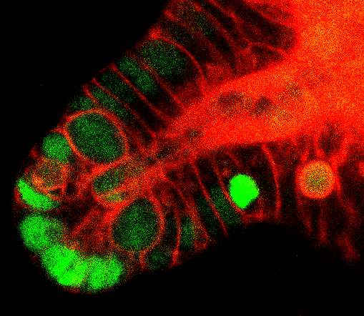
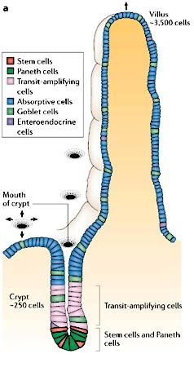
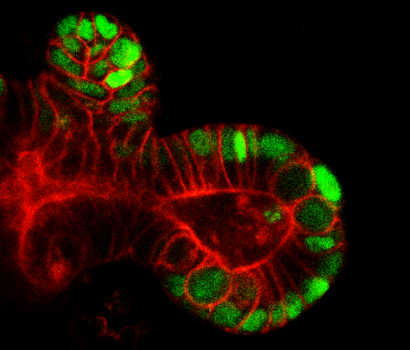
Introducing the problem I
The data: 4D (3D + time) images of intestinal crypt
Crypt is an invagination into mucosa of intestine [1]
Where cells are actively proliferating to facilitate renewal of intestinal epithelium [3]
Patterns of cell division may be linked to diabetes
The distribution of epithelial cell types in the mammalian small intestine. [2]
The data: central slices.
[1] Barker et al. 2008. The intestinal stem cell. Genes & Dev. [2] Crosnier et at. 2006. Organizing cell renewal in the intestine: stem cells, signals and combinatorial control. Nature Reviews Genetics. [3] Yeung et al. 2011. Regulation of self-renewal and differentiation by the intestinal stem cell niche. Cellular and Molecular Life Sciences.
Notes:
In my project I have 4D images (3D + time) of intestinal crypt
Crypt is a kind of cavity in intestinal mucosa
It is covered with cells which are actively dividing
Pattern of this division might be liked to diabetes

Slide 3
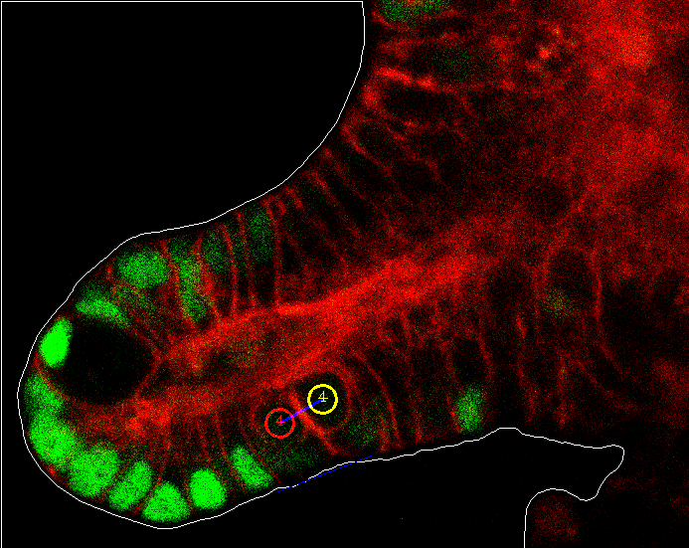
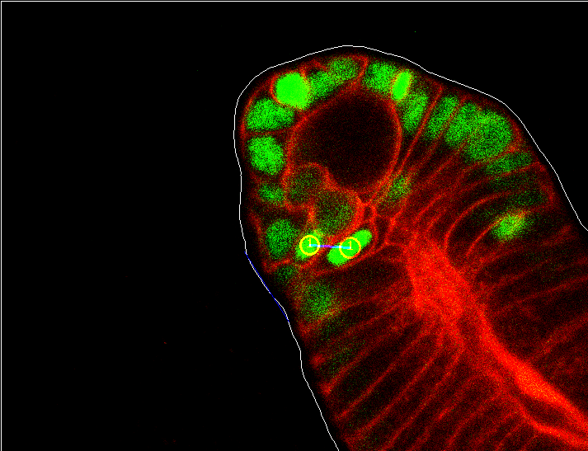
Introducing the problem II
The task: aid biologists to measure a statistics of angle between cells arisen from division and the crypt surface.
Almost parallel
Rather perpendicular

Slide 4

Introducing the problem III
The project parts:
Automatic extraction of crypt surface
Developing a method to measure angle between the crypt surface and daughter cells
Detection of mitosis events

Slide 5
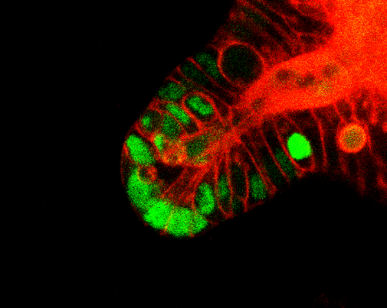
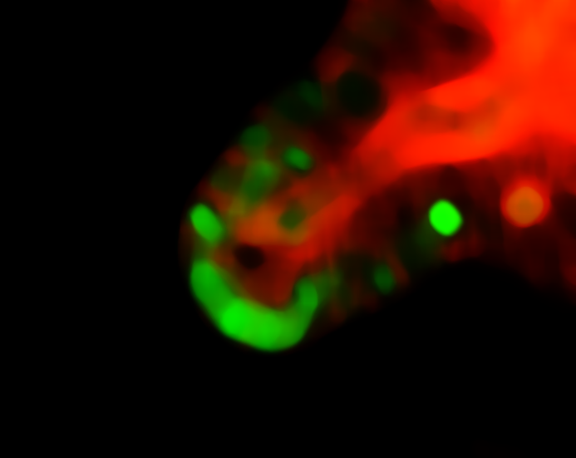
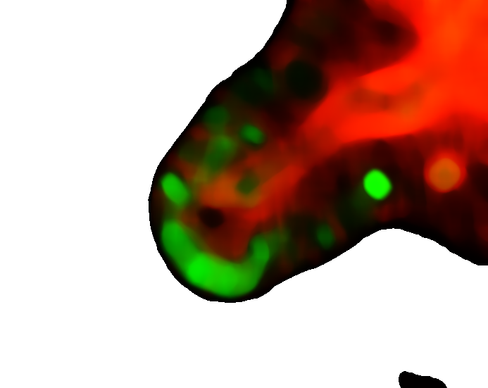

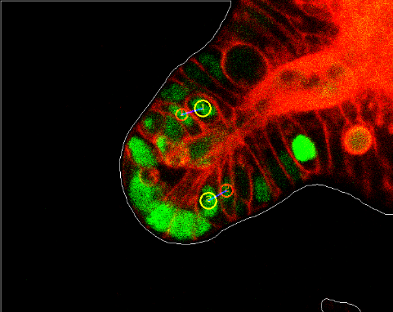
Extraction of crypt surface
Statistical Shape Models (SSM) [4] was considered.
Solved by Flood Fill algorithm [5] and subsequent extraction of the contour [6].
[4] Cootes et al. 2000. Statistical Models of Appearance for Computer Vision. [5] Flood Fill on Wikipedia: https://en.wikipedia.org/wiki/Flood_fill [6] Suzuki. 1985. Topological structural analysis of digitized binary images by border following. Computer Vision, Graphics, and Image Processing.
Notes:
With Dr. Wang we firstly considered to use SSM. However, as the background is plain-black, we can apply Flood Fill algorithm. We take black pixel in the border and expand until we hit not black. From this white and black mask we extract the border.

Slide 6
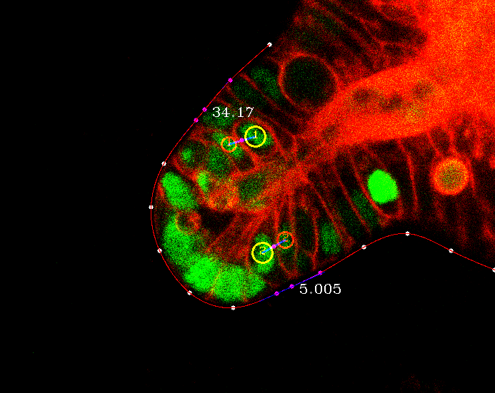
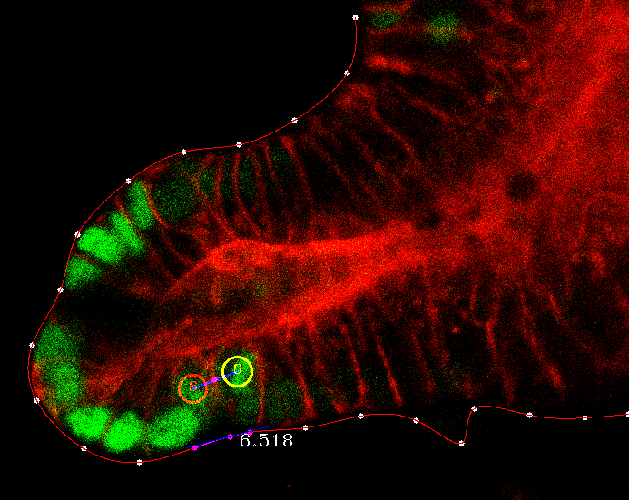
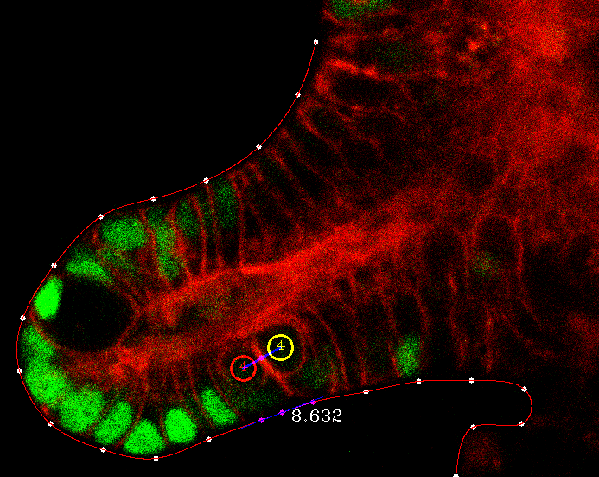

The method for measuring angle
Sample points of equal distance from the crypt
Interpolate using cubic spline [7]
Calculate an angle between:
a line connecting daughter cells and
tangent line at the point of the crypt closest to a central point of a line segment connecting the daughters
[7] Cubic Spline on Wolfram: http://mathworld.wolfram.com/CubicSpline.html

Slide 7

The project parts
Automatic extraction of crypt surface
Developing a method to measure angle between the crypt surface and daughter cells
Detection of mitosis events

Slide 8
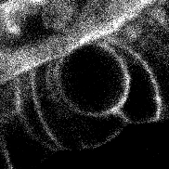
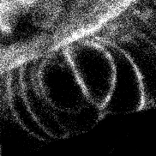
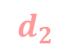
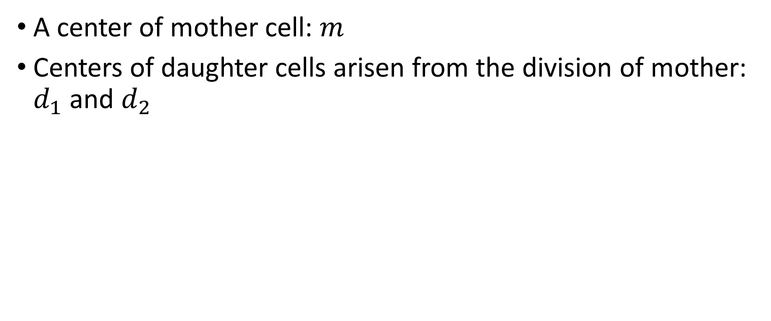
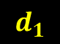

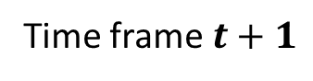
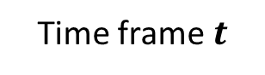
What is a mitosis event?
A center of mother cell: $m$
Centers of daughter cells arisen from the division of mother: $d_{1}$ and $d_{2}$
$$m$$
$$d_{1}$$
$$d_{2}$$
Time frame $t$
Time frame $t+1$
Notes:
Daughters are always in the time frame following right after mother’s time frame

Slide 9
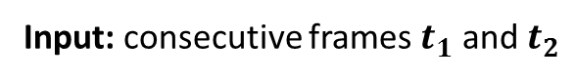
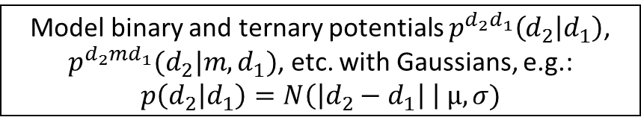
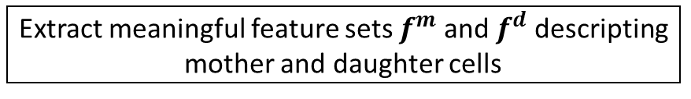
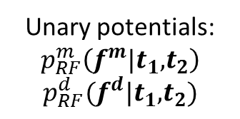
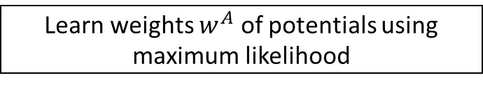
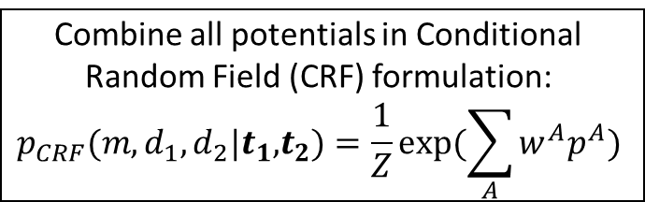
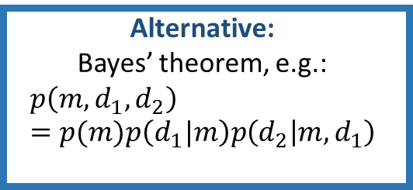
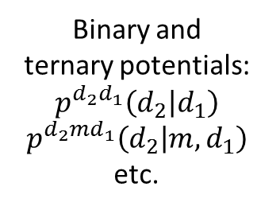
Detection of mitosis: the workflow
Input: consecutive frames $t_{1}$ and $t_{2}$
Extract meaningful feature sets $f^{m}$ and $f^{d}$ descripting mother and daughter cells
Model binary and ternary potentials $p^{{d_{2}d}_{1}}\left(d_{2} | d_{1}\right)$, $p^{d_{2}md_{1}}(d_{2}|m, d_{1})$, etc. with Gaussians, e.g.:
$$p\left(d_{2} | d_{1}\right)=N\left(\left|d_{2}−d_{1}\right| \right| µ, σ)$$
Train two random forests:
one for mother, one for daughter
Estimate µ and 𝜎 for each potential from training set
Unary potentials:
$$p_{RF}^{m}\left(f^{m}|t_{1}\text{,}t_{2}\right)$$
$$p_{RF}^{d}(f^{d}|t_{1}\text{,}t_{2})$$
Combine all potentials in Conditional Random Field (CRF) formulation:
$$p_{CRF}(m, d_{1},d_{2}|t_{1}\text{,}t_{2})=\frac{1}{Z}exp⁡(\sum_{A}{w^{A}p^{A}})$$
Binary and
ternary potentials:
$$p^{{d_{2}d}_{1}}\left(d_{2} | d_{1}\right)$$
$$p^{d_{2}md_{1}}\left(d_{2} | m, d_{1}\right)$$
etc.
Alternative:
Bayes’ theorem, e.g.:
$$p\left(m, d_{1}, d_{2}\right)=p(m)p\left(d_{1}|m\right)p\left(d_{2} | {m,d}_{1}\right)$$
Learn weights $w^{A}$ of potentials using maximum likelihood
Output: sets of tuples $(m, d_{1},d_{2})$ with $p_{CRF}\left(m, d_{1},d_{2} | t_{1},t_{2}\right)>threshold$

Slide 10
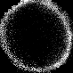
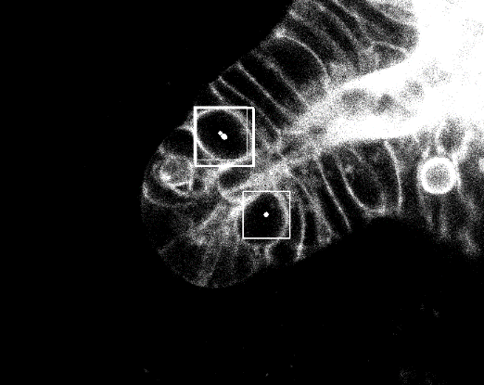
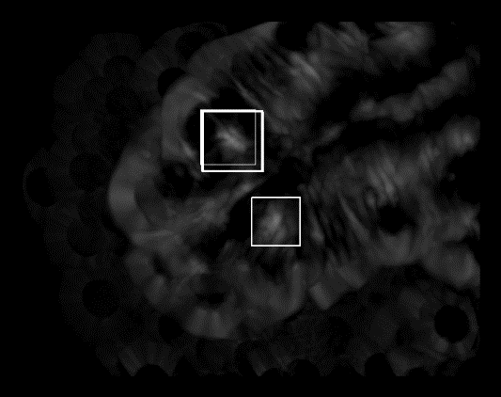
Features: template matching [8]
The algorithm:
Choosing so-called template: image containing only the object
At each point of target image calculate a similarity measure (I took correlation coefficient) of a local patch and the template
Problems:
Cells may have different sizes and not exactly circular shape -> search only for a single template, but for it’s linear transformations
Gives false positives (and negatives) -> use in combination with other features
Set of templates
Mother cells detection
Correlation coefficient

Slide 11
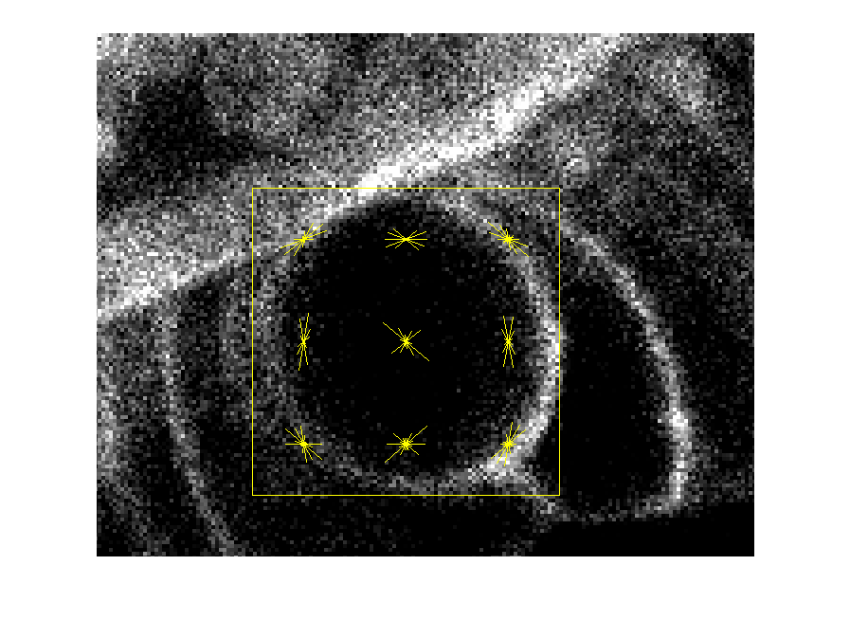
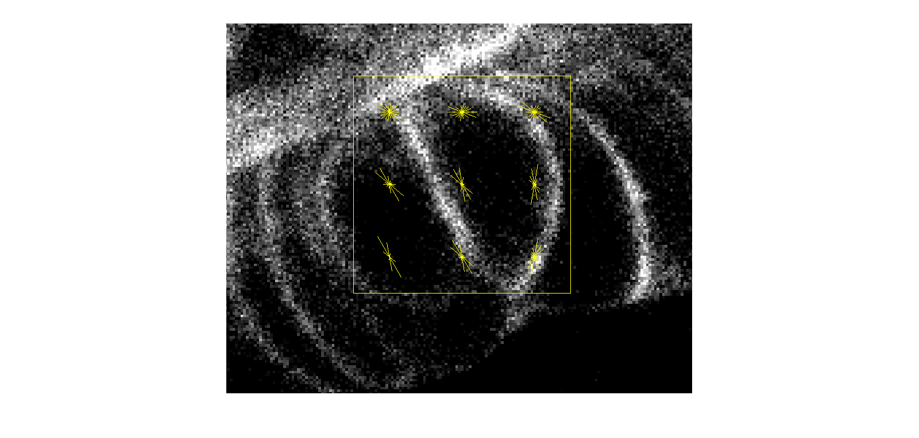
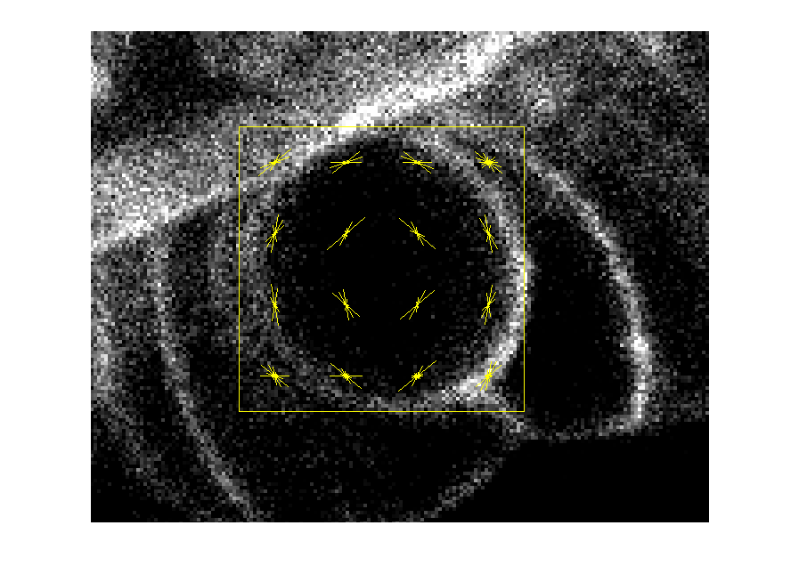
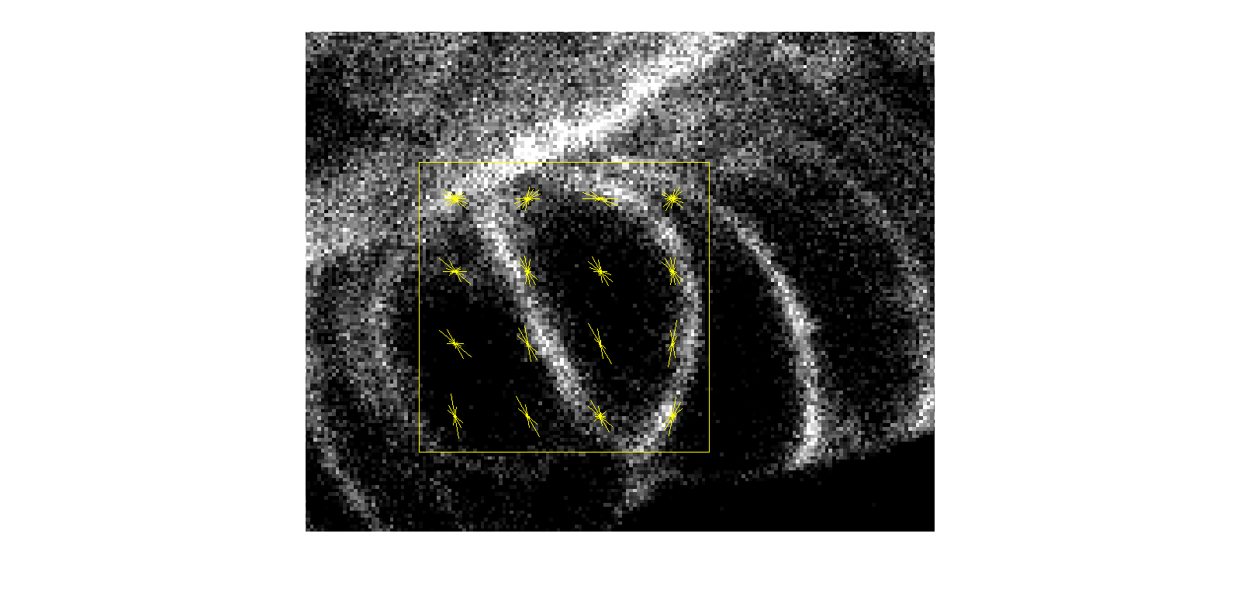
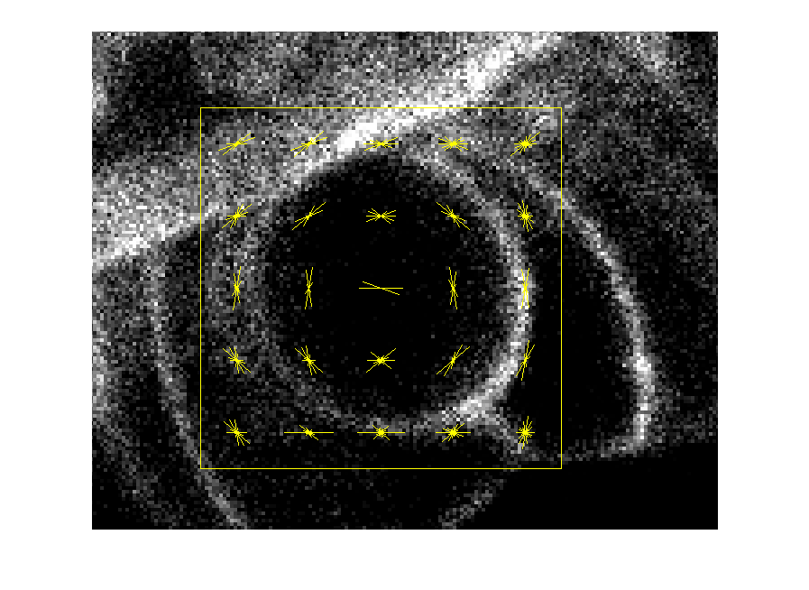
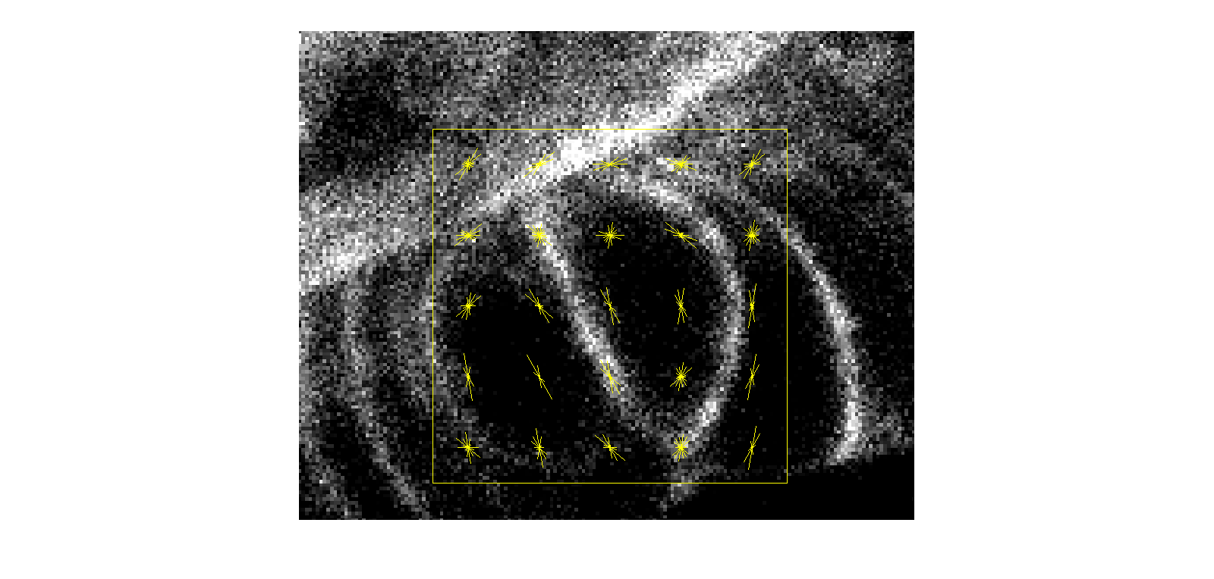
Features: histogram of oriented gradients (HOG) [9]
The algorithm:
Compute gradient at each pixel of the patch
Each gradient votes for a bin in orientation-based histogram
Problems:
Not rotation-invariant
Choose number of blocks:
Number of parameters, Descriptiveness

Slide 12
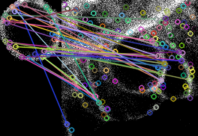
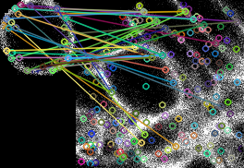
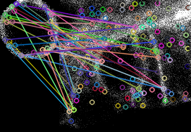
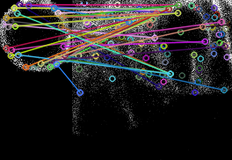
Features: SIFT (Scale-Invariant Feature Transform) [10]
The algorithm:
Finds interesting points (keypoints) in both source and target images
Finds closest points on the target image to points on the source by comparing their HOGs
Problems: is not suitable for this task, as cell is a homogeneous object
(Trying to find template on the image it was taken from.)

Slide 13
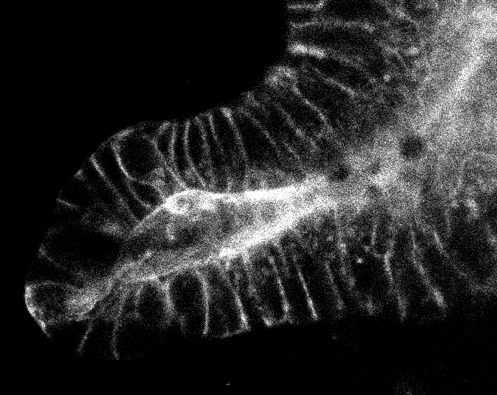
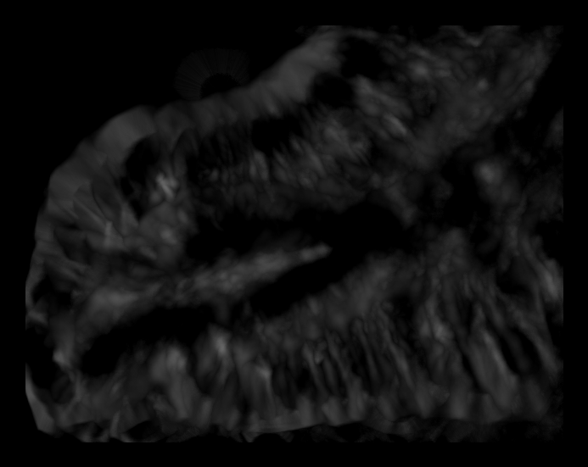
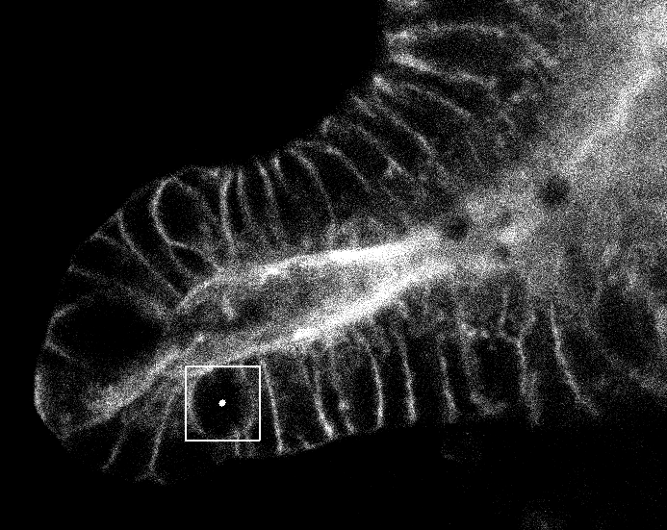
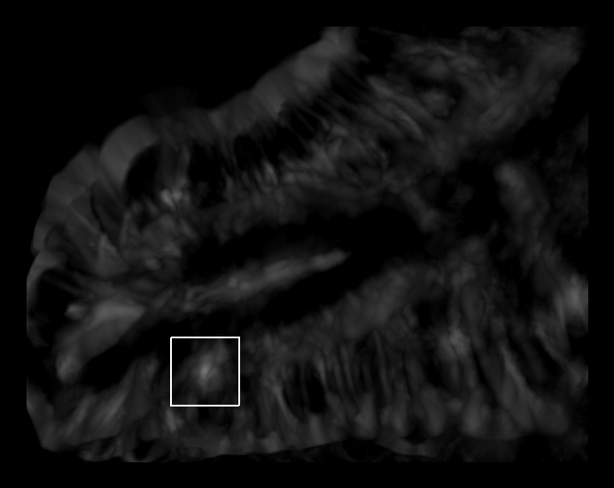
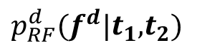

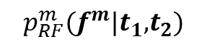



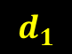


Training classifier to learn unary potentials
Extract discriminative features: template matching, HOG, color-based features
Train two random forest [11] classifiers: for mothers and for daughters
Ambiguity
$$t_{2}$$
$$p_{RF}^{d}(f^{d}|t_{1}\text{,}t_{2})$$
$$t_{1}$$
$$p_{RF}^{m}(f^{m}|t_{1}\text{,}t_{2})$$
$$d_{2}$$
?
$$d_{1}$$
$$d_{2}$$
$$m$$
$$d_{1}$$
Notes:
Second block

Slide 14
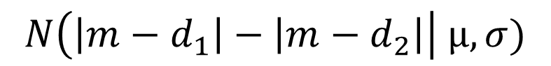
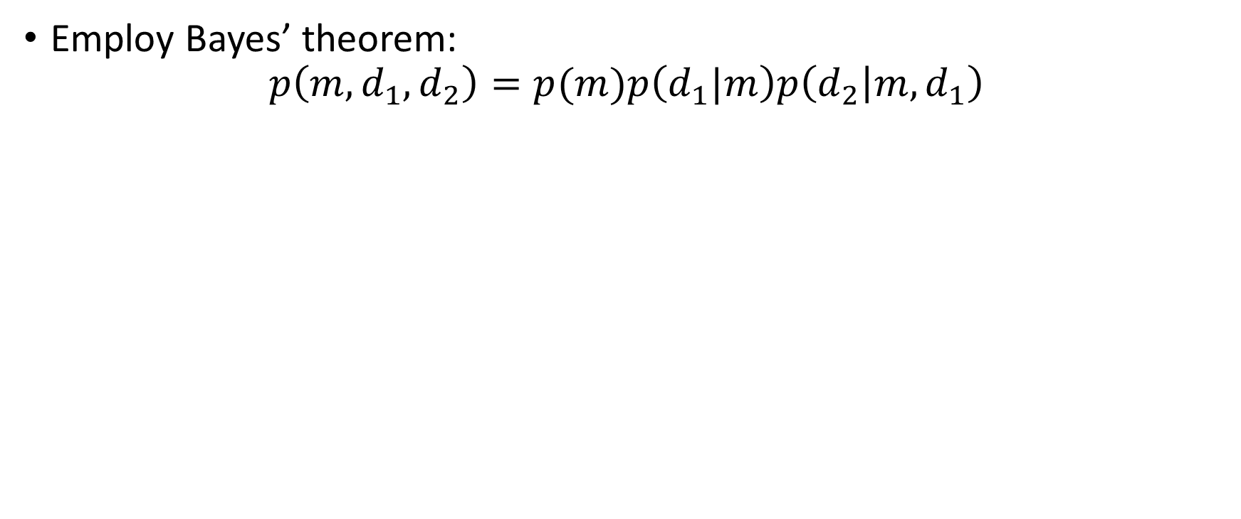
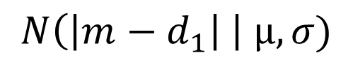

Estimating joint likelihood: Bayes I
Employ Bayes’ theorem:
$$p\left(m, d_{1}, d_{2}\right)=p(m)p\left(d_{1}|m\right)p\left(d_{2} | {m, d}_{1}\right)$$
$$p_{RF}^{m}\left(f^{m}(m){|t}_{1}\text{,}t_{2}\right)$$
$$N\left(\left|m−d_{1}\right| \right| µ, σ)$$
$$N\left(\left|m−d_{1}\right|−\left|m−d_{2}\right|\right| µ, σ)$$

Slide 15




Estimating joint likelihood: Bayes II
A more feasible variant:
$$p\left(m, d_{1}, d_{2}\right)=p(m)p\left(d_{1}\right)p\left(d_{2} | d_{1}\right)$$
Drawbacks:
probability estimates could be inaccurate
restricted in number of potentials to incorporate
$$p_{RF}^{m}\left(f^{m}(m){|t}_{1}\text{,}t_{2}\right)$$
$$p_{RF}^{d}\left(f^{d}(d){|t}_{1}\text{,}t_{2}\right)$$
$$N\left(\left|d_{2}−d_{1}\right| \right| µ, σ)$$

Slide 16












Conditional Random Field (CRF) formulation [12, 13]
$$x$$
$U = \left\{m, d_{1}, d_{2}\right\}$
$B=\left\{\left(m,d_{1}\right),\left(m,d_{2}\right), \left(d_{1},d_{2}\right)\right\}$
$T = \{(m, d_{1},d_{2})\}$
$$p\left(m, d_{1},d_{2} | x\right)=\frac{1}{Z(x)}\prod_{i∊U}{ψ_{i}\left(i, x\right)}\prod_{(i, j)∊B}{ψ_{ij}(i, j)}\prod_{(i, j, k)∊T}{ψ_{ijk}(i, j, k)}$$
$${ ψ}_{d_{1}}$$
$${ ψ}_{m}$$
$${ ψ}_{d_{2}}$$
$${ d}_{1}$$
$${ ψ}_{md_{1}}$$
$${ ψ}_{md_{2}}$$
$$m$$
$${ ψ}_{md_{1}d_{2}}$$
$${ d}_{2}$$
$${ ψ}_{d_{1}d_{2}}$$
Notes:
ESTIMATES conditional prob

Slide 17

CRF formulation: potentials
Unary potentials:
$$ψ_{m}\left(m,x\right)=\exp{\{w_{m}p\left(m\right)\}}$$
Binary potentials:
$$ψ_{d_{1}d_{2}}\left(d_{1},d_{2},x\right)=exp⁡\{w_{d_{1}d_{2}}N\left(\left|d_{2}−d_{1}\right| \right| µ, σ)\}$$
$$ψ_{{md}_{1}}\left(m,d_{1},x\right)=exp⁡\{w_{{md}_{1}}N\left(\left|m−d_{1}\right| \right| µ, σ)\}$$
Ternary potential:
$$ψ_{{md}_{1}d_{2}}\left(m,d_{1},d_{2},x\right)=exp⁡\{w_{{md}_{1}d_{2}}N\left(\left|m−d_{1}\right|−\left|m−d_{2}\right|\right| µ, σ)\}$$

Slide 18

CRF formulation: learn weights
In some works weights are chosen empirically. [14, 15]
Disadvantages:
Requires time to tune
May be inaccurate
Better option: learn weights by maximizing likelihood [16]:
$$\hat{w}={\arg{max}}_{w}\prod_{\left\{n=1\right\}}^{N}{p(m^{n},d_{1}^{n}, d_{1}^{n}|x^{n})}$$
$m^{n},d_{1}^{n}, d_{1}^{n}$ - labels of $n$th sample $x^{n}$

Slide 19
The schedule
The task | Time
Feature extraction implementation and testing. | 22.06-10.07
Preparation of data for classifiers to learn unary potentials. | 1 week
Training classifiers. | 1 week
Mitosis event detection with Bayes and performance assessment. | 2 weeks
Preparation of data for mitosis event (joint) detection with CRF. | 1 week
Mitosis event detection with CRF, performance assessment and comparison with Bayes. | 2 weeks
Writing final report and preparing final presentation. | 1 week

Slide 20
References
[1] Barker, N., van de Wetering, M., and Clevers, H. 2008. The intestinal stem cell. Genes & Dev. 22:1856-1864.
[2] Crosnier, C., Stamataki, D., Lewis, J. 2006. Organizing cell renewal in the intestine: stem cells, signals and combinatorial control. Nature Reviews Genetics. 7(5):349-359.
[3] Yeung, T.M., Chia, L.A., Kosinski, C.M., Kuo, C.J. 2011. Regulation of self-renewal and differentiation by the intestinal stem cell niche. Cellular and Molecular Life Sciences. Vol. 68, no. 15, pp. 2513–2523.
[4] Cootes, T.F., Taylor, C. J. 2000. Statistical Models of Appearance for Computer Vision.
[5] Flood fill Wikipedia: https://en.wikipedia.org/wiki/Flood_fill
[6] Suzuki, S. (1985). Topological structural analysis of digitized binary images by border following. Computer Vision, Graphics, and Image Processing, 30(1), 32-46.
[7] Judd, Kenneth L. (1998). Numerical Methods in Economics. MIT Press. p. 225. ISBN 978-0-262-10071-7.
[8] Template Matching Techniques in Computer Vision: Theory and Practice. Roberto Brunelli. March 2009. ISBN: 978-0-470-51706-2
[9] Dalal, N., & Triggs, B. (2005, June). Histograms of oriented gradients for human detection. In Computer Vision and Pattern Recognition, 2005. CVPR 2005. IEEE Computer Society Conference on (Vol. 1, pp. 886-893). IEEE.
[10] Distinctive image features from scale-invariant keypoints. David G. Lowe, International Journal of Computer Vision, 60, 2 (2004), pp. 91-110.
[11] Christopher M. Bishop, Pattern Recognition and Machine Learning. Springer, Berlin, New York, 2006.
[12] Lafferty, J., McCallum, A., Pereira, F. 2001. Conditional random fields: Probabilistic models for segmenting and labeling sequence data. Proceedings of 18th International Conference on Machine Learning.
[13] Sutton, C., McCallum, A. 2010. An Introduction to Conditional Random Fields. v1. arXiv:1011.4088.
[14] H. Wang, W. Shi, X. Zhuang, X. Wu, K. Tung, S. Ourselin, P. Edwards, and D. Rueckert, “Landmark detection and coupled patch registration for cardiac motion tracking,” in SPIE, 2013, vol. 8669.
[15] V. Belagiannis, S. Amin, M. Andriluka, B. Schiele, N. Navab, and S. Ilic, “3D pictorial structures for multiple human pose estimation,” in CVPR, 2014, pp. 1669–76.
[16] Wang, L., Belagiannis, V., Marr, C., Theis, F., Yang, G., Navab, N. 2015. Anatomic-Landmark Detection Using Graphical Context Modelling.

